Slide 1
MEMORY MANAGEMENT AND THREADING

Slide 2
Objectives
Understand destructors
Understand IDisposable, how to use it with 'using' statement
Understand thread life cycle, background and foreground threads
Understanding thread class

Slide 3
MEMORY MANAGEMENT

Slide 4
What is Destructor?
Destructors are used to destroy instances of classes.
Destructors cannot be defined in structures. They are only used with classes.
A class can only have one destructor.
Destructors cannot be inherited or overloaded.
Destructors cannot be called. They are invoked automatically.
A destructor does not take modifiers or have parameters.

Slide 5
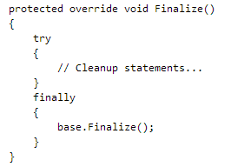
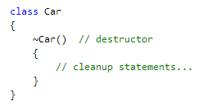
Destructor and Finalize
The destructor implicitly calls Finalize on the base class of the object. Therefore, the previous destructor code is implicitly translated to the following code
This means that the Finalize method is called recursively for all instances in the inheritance chain, from the most-derived to the least-derived
Notes:
Note:
The programmer has no control over when the destructor is called because this is determined by the garbage collector. The garbage collector checks for objects that are no longer being used by the application. If it considers an object eligible for destruction, it calls the destructor (if any) and reclaims the memory used to store the object. Destructors are also called when the program exits.
It is possible to force garbage collection by calling Collect, but most of the time, this should be avoided because it may create performance issues.

Slide 6
Destructor to Release Resources
In general, C# does not require as much memory because the .NET Framework garbage collector implicitly manages the allocation and release of memory for your objects.
However, when your application encapsulates unmanaged resources such as windows, files, and network connections, you should use destructors to free those resources.
When the object is eligible for destruction, the garbage collector runs the Finalize method of the object

Slide 7
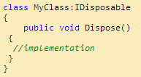
IDisposable Interface and Dispose Method
The IDisposable interface contains only one public method with signature void Dispose().
Implement this method to close or release unmanaged resources such as files, streams, and handles held by an instance of the class that implements this interface.
This method is used for all tasks associated with freeing resources held by an object.
When implementing this method, objects must seek to ensure that all held resources are freed by propagating the call through the containent hierarchy.

Slide 8
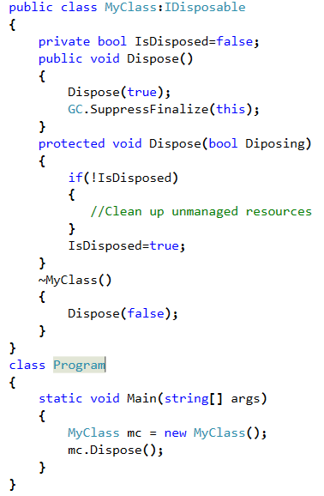
Using Desctructor and IDisposable interface Together
Notes:
Note:
Here the overload of Dispose(bool) does the cleaning up, and all the cleaning up code is written only in this method. This method is called by both the destructor and the IDisposable.Dispose(). We should take care that the Dispose(bool) is not called from any where else except from the IDisposable.Dispose() and the destructor.
When a client calls IDisposable.Dispose(), then the client deliberately wants to clean up the managed and unmanaged resource, and so the cleaning up is done. One thing you must have noticed is that we called GC.SupressFinalize(this) immediately after we cleaned up the resource. This method tells the Garbage Collector that there is no need to call its destructor because we have already done the clean up.
Notice that in the above example, the destructor calls the Dispose with parameter as false. Here, we are ensuring that the Garbage collector collects the managed resources. We only do the cleaning up of unmanaged resource.

Slide 9
Using Objects That Implement IDisposable
The CLR’s garbage collector reclaims the memory used by unmanaged objects, but types that use unmanaged resources implement the IDisposable interface to allow this unmanaged memory to be reclaimed.
When you finish using an object that implements IDisposable, you should call the object's IDisposable.Dispose implementation.
You can do this in one of two ways:
With the C# using statement
By implementing a try/finally block

Slide 10
The ‘using’ Statement
The using statement in C simplify the code that you must write to create and clean up an object.
The using statement obtains one or more resources, executes the statements that you specify, and automatically disposes of the object.
However, the using statement is useful only for objects that are used within the scope of the method in which they are constructed.

Slide 11
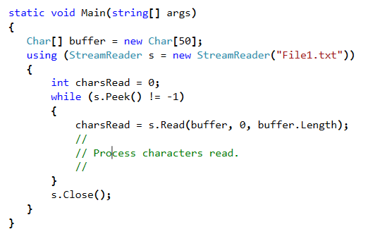
Example
Notes:
Note:
Although the StreamReader class implements the IDisposable interface, which indicates that it uses an unmanaged resource, the example doesn't explicitly call the StreamReadr.Dispose method. When the C# compiler encounters the using statement, it emits intermediate language (IL) that is equivalent to the code that explicitly contains a try/finally block.

Slide 12
Multitasking
Every application executes in its own address space or process.
E.g. MS Word (Creating a document) or WinAmp (listening songs)
A processor can execute applications in multiple processes concurrently.
Ability to execute different applications or tasks by the processor is called multitasking
The scheduling algorithm of the operating system decides it
Based on time slicing – pre-emptive
Creating a document in MS Word and listening to a song in WinAmp can be done concurrently
Operating System switches between the applications running in different processes
Each process has its own data which needs to be stored temporarily before switching to other process. This is called context.
Context switch is resource heavy
Notes:
Multitasking
Every application or a program executes in its own address space or also called process. Multiple such applications can run in their own processes. For example, MS Word is used for creating a document and WinAmp is used for listening to songs. A user can use both the tools at the same time.
A processor can execute applications in multiple processes concurrently. This ability to execute different applications or tasks by the processor is called multitasking. It is the scheduling algorithm of the Operating System (OS) that decides this execution.
This scheduling algorithm is based on the concept of time slicing. Every task is given a particular time slice. After the given time slice is over, OS switches to the other task for a given time slice. This switching is so fast that the user has an illusion that two tasks are executing concurrently.
Operating system needs to know the point from which it has to continue the task during the switch. Every process has its own data. OS should also store data temporarily before switching to another task. This is known as context. Thus OS stores the context and when it revisits the task as per the scheduling algorithm, it uses this information to start the execution from the point it left last. As the context too would require some memory, context switch can be considered to be resource heavy.

Slide 13
THREADING

Slide 14
Multithreading
CPU is idle between the context switch
Consider a scenario of a single application - MS Word
Spell check, grammar check runs while the editing is being done.
Ability of OS to run different parts of the same program or application concurrently is called multithreading.
Each part of the program is called “Thread”.
Thread can execute separate tasks independently with each task not dependent on other.
Two or more threads in an application can share some data.
Synchronization of threads is required in such a scenario as each thread can change the shared data.
Notes:
What is multithreading?
CPU has to wait till the time slice of a task is complete. The idea is to utilize the idle time of CPU by going one level below multitasking – multithreading.
Consider an example of MS Word. When a user is editing a document, concurrently spell check runs to check the spelling. User feels that both the tasks execute concurrently. Both the tasks editing as well as checking spelling are parts of the same application.
The ability of OS to run different parts of the same program or application concurrently is called multithreading. Each part of the program is called a “thread”. Each thread has a separate path of execution. In .NET, process is further divided into AppDomains (Application Domains). They can be considered as light weight sub-processes. Every application runs in a separate AppDomain. Multiple threads can be a part of single application.
Note: CLR loads managed code in an application context of a process called Application Domain or AppDomain. AppDomain is a part of the process. It provides isolation and security boundary for execution.
When can we write multithreaded applications?
Multithreaded applications can be written when the user needs to interact with the user interface while huge amount of data is being retrieved from some server.
They can also be used when different tasks in an application have different priority and high priority tasks need to be executed before low priority ones.
Also sometimes high precision calculations can be put on a separate thread till other tasks are being done.
Asynchronous programming can be coupled with web services to call web services asynchronously.
Though writing multithreaded applications help in utilizing the idle time of CPU, there is lot of performance issue if there are many threads in the application. Switching between multiple threads takes time and also to save the context of these threads is an overhead. Also controlling the code execution of multiple threads is a complicated task on the part of the developer.

Slide 15
Thread Life Cycle
Thread is a part of execution of an application. It has a life-cycle.
born
start
Notify or NotifyAll
ready
Completion of IO
quantum
expiration
dispatch
(assign a monitor)
running
wait
sleep
waiting
sleeping
I/O request issue
blocked
completion
On expiry of Sleep intervals
dead
Notes:
Thread Life Cycle:
As mentioned earlier, thread is a part of a program. It is part of an execution of an entire application. Each application runs on a main thread called the primary thread. Thread is actually a part of a process.
In .NET application, each process has multiple AppDomains. Application runs in the AppDomain. A thread can be a part of these applications.
Threads are called light weight processes because they run in the context of the application and take advantage of the resources for the particular application. There can be multiple such threads executing in an application. When one thread is in running state, other threads wait in a queue. OS decides the time slice for a thread and interrupts it at regular intervals. These intervals are in milliseconds.
Every thread has a life cycle. It is shown above in the diagram.
When a thread is created, it is said to be in born state.
When this thread is added in a queue schedule of CPU, it is said ready to run state.
When the thread is started using Start() method explicitly, it enters the running state.
A running thread enters the sleep state for specific time interval. When the time elapses, thread is said to be awake again. Sleeping thread does not need processor time.
The thread goes in waiting state when it waits for other thread. The other thread performs its task. First thread resumes its task when the other thread notifies it.
A thread can enter blocked state when it waits for a resource, it cannot access. That resource is used by other thread. When the other thread completed accessing it, the first thread resumes running state.
A thread can enter into suspended state when the execution is paused when a high priority thread starts executing. The it can resume from where it left execution.
A thread is said to be dead when it completes the task or if it is aborted due to any error condition.

Slide 16
Thread class
System.Threading namespace provides a set of classes and other types that support in creating multithreaded applications.
Thread Class
Represents a thread, helps to create it, control it, set its priority and get its status
Some methods:
Method Name | Description
static void Sleep(int millisecondsTimeout ) | Suspends the current thread for a particular time interval.
void Start() | Causes the state of thread to be in running state. It is an overloaded method.
void Join() | Blocks the calling thread until the thread terminates
void Abort() | Raises a ThreadAbortException in the thread on which it is invoked, to begin the process of terminating the thread. Calling this method usually terminates the thread.
CurrentThread | property; gets the currently running thread
Name | gets or sets the name of the thread
ThreadPriority | Gets or sets a value indicating the scheduling priority of a thread.
Notes:
Thread class:
System.Threading namespace provides a set of classes and other types like Thread class, ThreadStart delegate, Monitor class, Interlocked class, etc. that support in creating multithreaded applications.
Thread class helps to create a thread and control it. It provides a number of methods and properties that help to handle threads while using it in an application.
Threads can enter into sleep state for specified time interval if Sleep() method is used.
Thread execution has to stop, so that all the other threads can finish their execution and the modules which are dependent on these threads can start their execution. To make this possible threading provides a solution, by having the Join() feature.
Sometimes multiple threads can run in an application. Some of the threads have the responsibility of performing high priority tasks while some may perform low priority tasks. For example, interaction with the user interface should have high priority than any other thread in an application. Other threads continue to run as per the time slice given by the OS. When the user interacts with the UI, it gets priority over other threads and it handles the event.
Thread userThread = new Thread(new ThreadStart(SomeMethod);
userThread.Priority = ThreadPriority.Highest;
ThreadPriority is an enumeration with values like Highest, AboveNormal, Normal, BelowNormal and Lowest.
Simple steps of writing multithreaded application:
Break up the application into individual tasks
List the flow of execution of these tasks
Find out which tasks would take more CPU time
Find out tasks which can execute independently
Find out tasks that are dependent on each other and the data they share
Assign thread to each task identified
Start the thread

Slide 17
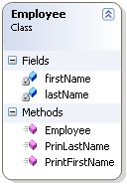
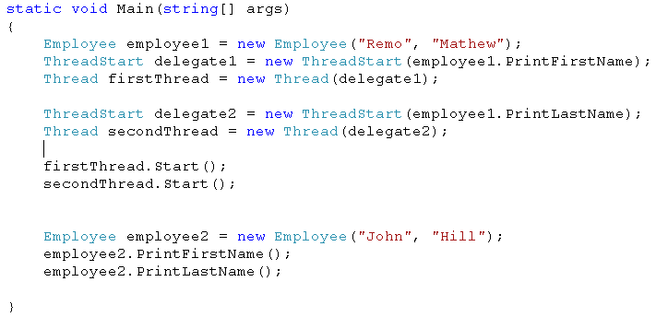
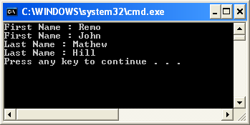
Thread class - example
A Simple Example of Multithreading
Call to the methods on threads
Normal method call from Main
used by the client code
Output – unpredicted depending on the scheduling algorithm of OS
Notes:
In a simple example mentioned above, Employee class is assumed to be present. This class has two data members – first name and last name. It has a parameterized constructor for initializing the data members. Two methods – PrintFirstName() and PrintLastName() are present.
Two threads are created. To instantiate a thread, ThreadStart delegate is required. The methods that executes on a thread is represented by ThreadStart delegate. The method is not called till the Start() method is called. Even static method can also be used if required.
The output obtained when the two threads start executing is unpredicted. The output depends on the scheduling algorithm of the operating system. The threads start executing asynchronously when Start() method is called.

Slide 18
What are Foreground and Background Threads?
Thread can be either foreground or background thread.
Foreground thread keep the execution environment running.
Background thread run in the background. It stops once the foreground thread stops.
IsBackround property of a thread determines whether the thread is background.
By default the thread is foreground.
An application runs on the main thread.
If some tasks are time consuming and their execution and output does not affect other threads in the application, such threads are made as background thread.
Notes:
Foreground and background Threads
Threads can either run as foreground or background thread. By default every created via thread.Start () method, is a foreground thread. The foreground thread always keep the application in running state. When the foreground thread stops, the background thread stops immediately. But there is no exception thrown due to this abrupt termination of background thread in this way.
If there are no threads created, the application runs on a single thread. Such an application is called as thread-safe application. But if there is a large amount of data retrieval in such an application, then the application becomes unresponsive till the data retrieval is complete. In such a case, data retrieval can be put as a background thread while the user can still work with the application.
In a normal case, an application runs on a single thread.
By default the thread is a foreground thread. IsBackground property is used to set it as background thread.
Thread userThread = new Thread(new ThreadStart(SomeMethod);
userThread.IsBackground = true;

Slide 19
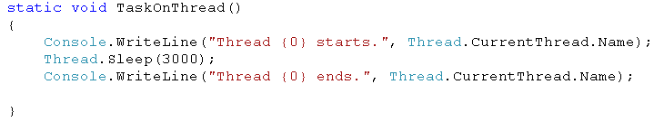
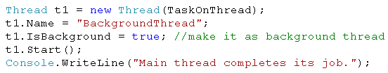
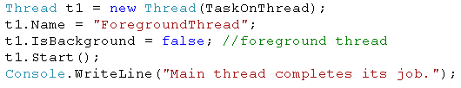
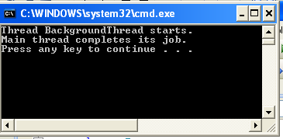
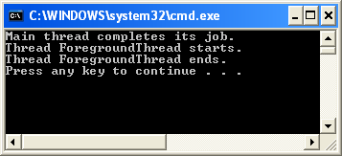
Foreground and Background Threads - example
I
II
Notes:
In the simple example shown on the slide, code written in box I and II call the same method “TaskOnThread”.
But in first case, the thread is made as background thread. If the output is observed, task on the background is not completed once the foreground thread terminates.
In the second case, the thread is a foreground thread. The task is completed on the foreground thread.
Foreground thread complete execution and keeps the application in running state.

Slide 20
Why Synchronization?
Two or more threads sharing the same data.
Data becomes inconsistent.
Two important problems
Race Condition
Two threads try to reach a particular block of code first
Deadlock
One thread tries to lock a resource which the other thread has already locked.
Synchronization of threads should be done to avoid the problems.
Notes:
Why Synchronization?
When threads perform individual specific task and do not share any data, application execute smoothly. But when two or more threads share same data, then the application shows inconsistent behavior. To avoid this, the threads sharing the same data need to be synchronized.
Consider an example in which a variable named “count” is incremented in a method. This incrementation though appears to be a single step but requires many CPU instructions – getting the value of count from the memory, adding 1 to it and then assigning it back to the same memory location. If one thread is trying to update the value of count and at the same time, time slice is given to other thread as per the scheduling algorithm, then the state of the variable goes in the inconsistent state. This condition is called race condition.
In yet another case, there may be a condition when each thread tries to lock a resource which the other thread has already locked; neither thread can make any progress. This situation is called a deadlock condition.
In short, asynchronous access to the shared data may give inconsistent or undesired results. To avoid this problem, controlled access to the threads need to be given. There are various synchronization techniques

Slide 21
Thread Synchronization Techniques
Synchronization of threads is required when two or more threads share same data.
Thread Synchronization techniques
Synchronization context
[Synchronization] attribute is used
Synchronized Code Regions
Using Monitor class
Using lock keyword in C#
Statements which need synchronization are put in a block
Manual Synchronization
Using Interlocked class
Inter – process Synchronization
Using Mutex class
MethodImplAttribute
Synchronizes an entire method in one single command
Notes:
Thread Synchronization Techniques:
1. Synchronization context – It is done by applying [Synchronization] attribute on a class. All objects created will be automatically synchronized. No code is written explicitly for synchronization. To use this attribute, System.Runtime.Remoting.Contexts namespace should be included.
[Synchronization]
class Resource
{
// data members
// methods – static or non static
}
The only problem is that if a particular method is not using thread sensitive data, it too is locked for synchronization purpose.
2. Synchronized Code Regions – Access to a block of a code can be restricted by using Monitor class. This restricted code is called as critical region. Different methods of the Monitor class like Enter(), Exit(), etc. help in synchronization.
(covered in the next slide in detail)
3. Using lock keyword – it helps to synchronize a set of statements that need to be synchronized between the threads.
public void SomeMethod()
{
lock(this)
{
// write the code that needs synchronization. Code is thread safe
}
}
Manual Synchronization – A variable shared by multiple threads can be synchronized manually by using Interlocked class. Methods like Increment(), Decrement() help to avoid race condition described earlier
class Student
{
static int count;
Student()
{
Interlocked.Increment(ref count); // synchronizes the variable
}
}
5. Inter-process synchronization – Mutex class is used for inter-process synchronization. It helps to acquire exclusive lock on a resource for a single thread.
6. MethodImplAttribute – It helps to synchronize an entire method in a single command. System.Runtime.CompilerServices should be included.

Slide 22
Synchronizing Code Regions - Monitor class
This class helps to control lock on an object for a particular region of the code for a single thread.
Region is called critical section.
No other thread can access the critical section till the lock is released.
Only reference types can be locked and not the value types.
Value type have to be boxed if used
Monitor class maintains information
Reference to the thread that holds the lock
Reference to the threads waiting in the queue to obtain the lock
Reference to the queue itself
Methods of Monitor class
Enter() , TryEnter()
Wait()
Pulse(), PulseAll()
Exit()
Notes:
Monitor class:
Monitor class provides a mechanism that synchronizes access to the objects. It is similar to working to lock keyword. This class helps to control lock on a particular object for a particular section of code. This is called critical section. The advantage of using this method is that only a small portion of code which needs to be thread safe is locked.
Monitor class cannot be instantiated. It has methods that ensure the synchronization of an object for a particular section of code.
Enter() , TryEnter()
Wait()
Pulse(), PulseAll()
Exit()
Enter() method is a point for beginning of the critical section whereas Exit() method is the point indicating the end of the critical section and to release the lock. If there are multiple code statements, this method ensure that only one thread can execute the code with the locked object. Other thread has to wait in this case. The code in the critical section should be placed in the try block and Exit() method should be placed in the finally block. When used with instance methods, current object invoking the method acquires the lock. In case of static methods, type of the object is used as a parameter to acquire the lock.
TryEnter() method tries to acquire an exclusive lock on the specified object. As the name suggests it tries to acquire the lock. If the thread cannot enter without blocking, the method returns false and this thread does not enter the critical section. This avoids the deadlock situation.
Wait() method is used to release the lock on the current object. This object can be used by another thread. It blocks the current thread. The current thread goes in the waiting queue until it re-acquires the lock. This is needed when some change in the state of the object is required as a result of operations performed by other thread. Now the other thread acquires an exclusive lock.
The thread that has now entered in the waiting queue remains there till it gets the signal from the Pulse() or PulseAll() method. Pulse() method is called then only the last thread in the waiting queue is affected. PulseAll() affects all the threads in the waiting queue. The thread that gets the signal from the Pulse() method now enters the ready queue and re-acquires the lock.

Slide 23
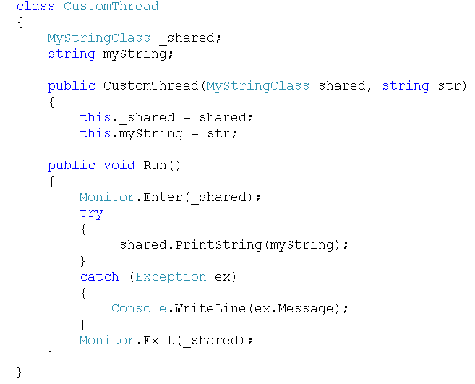
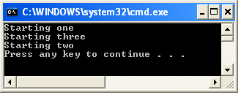
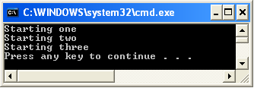
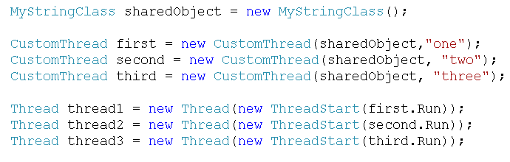
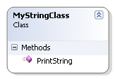
Example of using Monitor class
O/P if Monitor class is not used (inconsistent O/P)
Synchronizing using Monitor class
O/P when Monitor class is used (synchronization of code region)
Notes:
Explanation of the example:
sharedObject is an object of MyStringClass that is shared by three threads. The three threads call the method Run(). This method in turn calls the actual method called PrintString() using the shared object. Since the three threads try to manipulate the same sharedObject, the output obtained is inconsistent if synchronization is not used. This inconsistency is due to the time slicing given to the threads as per the scheduling algorithm of the OS.
Hence methods of Monitor class are used to synchronize the output. The block between Enter() and Exit() methods requires synchronized access to shared object. This prevents other thread from accessing the object.
Complete code
class Program
{
static void Main(string[] args)
{
MyStringClass sharedObject = new MyStringClass();
// shared object used by three threads
CustomThread first = new CustomThread(sharedObject, "one");
CustomThread second = new CustomThread(sharedObject, "two");
CustomThread third = new CustomThread(sharedObject, "three");
Thread thread1 = new Thread(new ThreadStart(first.Run));
Thread thread2 = new Thread(new ThreadStart(second.Run));
Thread thread3 = new Thread(new ThreadStart(third.Run));
try
{
thread1.Start();thread2.Start();thread3.Start();thread1.Join();thread2.Join();thread3.Join();
}
catch (Exception ex)
{
Console.WriteLine("Some problem...");
}
}
}
class CustomThread
{
MyStringClass _shared; // shared object’s reference
string myString;
public CustomThread(MyStringClass shared, string str)
{
this._shared = shared;
this.myString = str;
}
public void Run()
{
Monitor.Enter(_shared); // lock for a particular region of code
try
{
_shared.PrintString(myString);
}
catch (Exception ex)
{
Console.WriteLine(ex.Message);
}
Monitor.Exit(_shared);
}
}
class MyStringClass
{
public void PrintString(string myString)
{
Console.WriteLine("Starting " + myString);
try
{
Random rd = new Random(); // class to generate random numbers
Thread.Sleep(1000 * rd.Next(5));
}
catch (Exception ex)
{
Console.WriteLine(ex.Message);
}
}
}

Slide 24
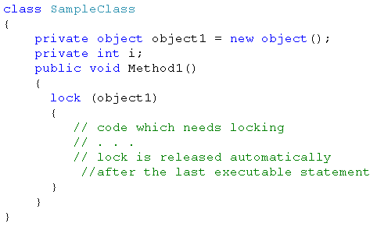
lock keyword
lock keyword helps to control lock on a particular object for a particular section of code.
Uses Enter() and Exit() methods
Simplified version of Monitor class
Notes:
lock keyword locks a particular object for a particular section of code. The other thread has to wait till the first thread releases the lock on the particular section.
Under the hoods, lock calls the Enter method at the start of the block and calls End method at the end of the block.
lock statement should not be used with public types or current objects. lock(this) can be problematic if the current object can be accessed publicly. Locking a private or protected object is safe.
In case of Monitor class, Exit() method has to be explicitly called to release the lock. But in case of lock statement, it is automatically ensured that Monitor.Exit() method is called.
In the code snippet mentioned on the above, lock statement locks a particular object for one thread. Other thread cannot access a particular section of code till the lock is released by the first thread.

Slide 25
Inter-process synchronization - Mutex Class
A synchronization technique that is used for inter-process synchronization.
Gives exclusive access to a shared resource to only one thread. The other thread that also needs access is suspended till the first thread releases the mutex.
Mutex are of two types
Local Mutex
Mutex that exists only within the process
Unnamed mutex
System Mutex
Mutex that is visible throughout operating system i.e. all processes
Named mutex
Notes:
Inter-process synchronization
Mutex class is used mainly for inter-process synchronization. It helps to give exclusive access to a shared resource to only one thread at a time. If a particular thread acquires a mutex, the second thread in queue is suspended till the first thread releases the mutex.
If several threads share access to a database, the threads can use a mutex object so that only one thread can write to the database at a time.
Mutex are of two types:
Local or unnamed mutex – It exists only within the same process. Any thread having reference to the mutex object within the process, can acquire the mutex. It is used to synchronize the tasks within the process.
System or named mutex – It is a system wide mutex and can be visible by all processes of an OS. System mutex can be created using one of the parameterized constructor of the Mutex class (discussed in the next slide).
Any thread with a handle to a mutex object can use one of the wait functions (provided by Mutex class) to request ownership of the mutex object. Other threads wait. If more than one thread is waiting on a mutex, a waiting thread is selected, not on First In First Out (FIFO) basis. The thread acquiring the mutex releases it . If a thread terminates ownership to the mutex before releasing it, then the mutex is said to be abandoned mutex.

Slide 26
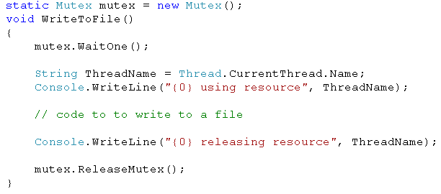
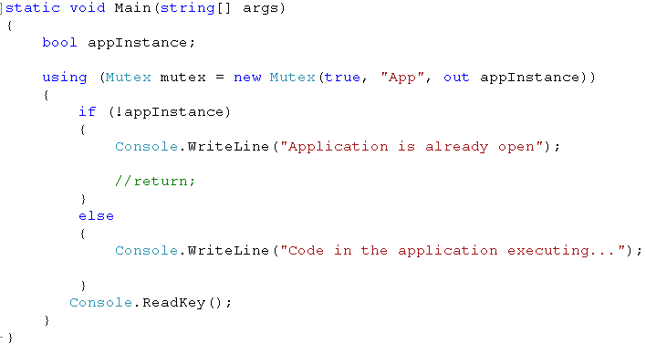
Mutex Class - Example
I
II
Notes:
The code snippet I mentioned on the slide has an unnamed mutex. The method WriteToFile() will have code to write to a file. If this method is called by three different threads, writing concurrently to a file is not possible. So synchronization is necessary. Mutex class can be used. WaitOne() method is called by a particular thread to request ownership. The call blocks till the mutex is available. ReleaseMutex() method is used to release the mutex. Mutex can be released by the thread that owns it.
In the code snippet II mentioned on the slide, Mutex is acquired by the thread running for Main() method. This code snippet ensures only one instance of the application can be executed at a time.
A boolean variable by name “appInstance” is created.
An object of class Mutex is created. The parameterized constructor used in the snippet takes three parameters.
First parameter is passes as true to indicate that the calling thread should get ownership of the named mutex created as a result of the call.
Second parameter is the name of the mutex. If the value is null, then it is unnamed mutex.
Third parameter is passed uninitialized, so out keyword is used. When the method returns, this parameter has the value true if the mutex is a local mutex(no name to the mutex given as in case of intra process synchronization). The value is false if the specified named mutex already exists.
If name is not null as in the code snippet above, first parameter is true, the calling thread owns the named mutex only if appInstance is true after the call.

Slide 27
Reference
For more details, please visit
http://www.codeproject.com
http://msdn.microsoft.com/en-us/library
Notes:
Reference

